Slide 1
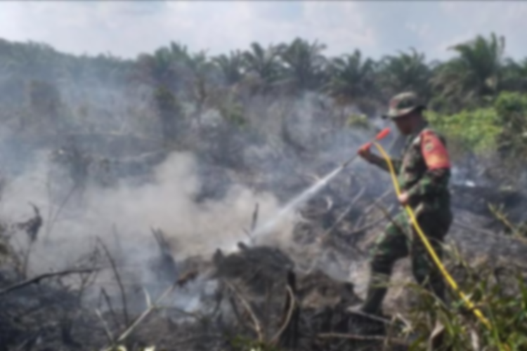
Fire aware Turning fire data into Insight and action
NASA SpaceApps Challenge 2019

Slide 2
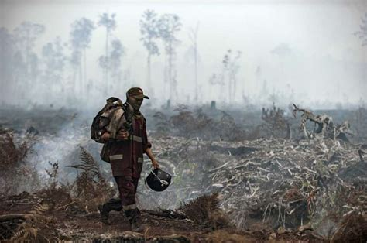
Forest fires are costly
In 2016, wildfires cost the United States (ref: NIST):
Infrastructure - $400 billion in damage in California alone
Fire-fighting - $2.9 billion over the entire USA
Greenhouse gas release - 4 % to 6 % of annual emissions from human activities
Timber products industry = 354 to 605 million USD
Economic - Destroyed infrastructure, blocked roads, blackouts
Deaths from smoke inhalation - 21,095

Slide 3
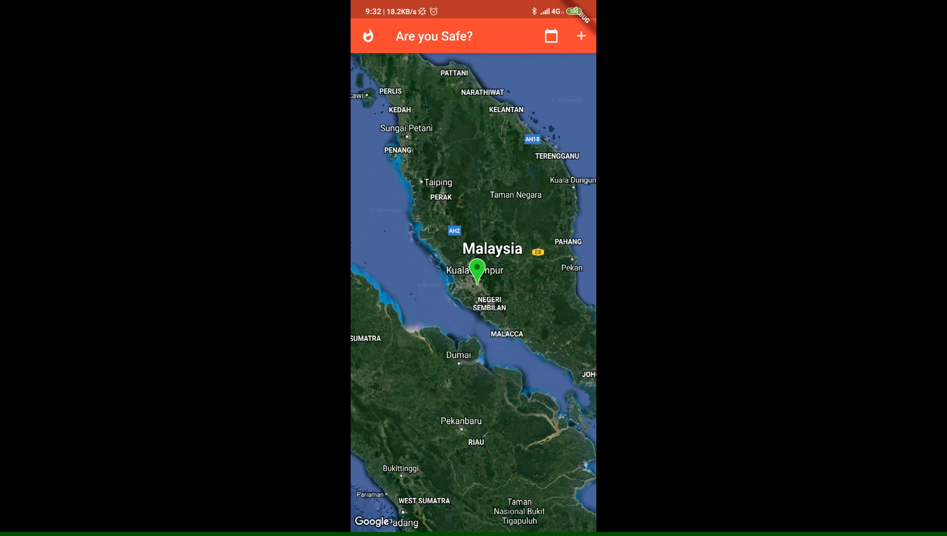
Our core premises
Mobile app
Fire situation visualisation
Citizen reporting: Upload media, verification with Machine Learning
Danger notification
Auto-finding rescue paths to safe zones using Maps API

Slide 4
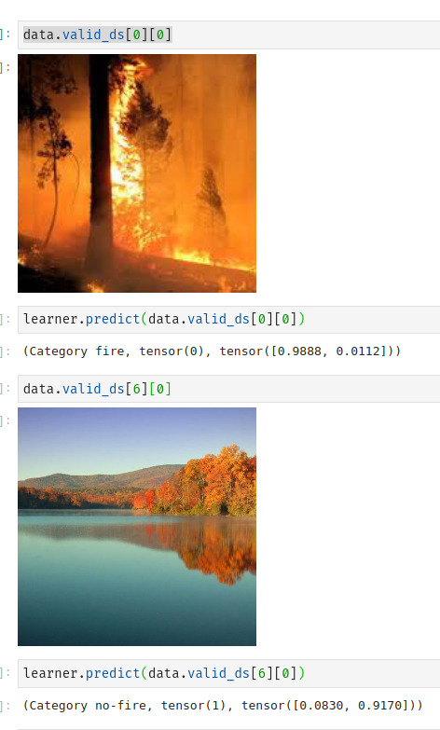
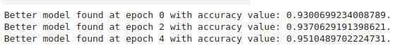
Our core premises
Mobile app
The ML model

Slide 5
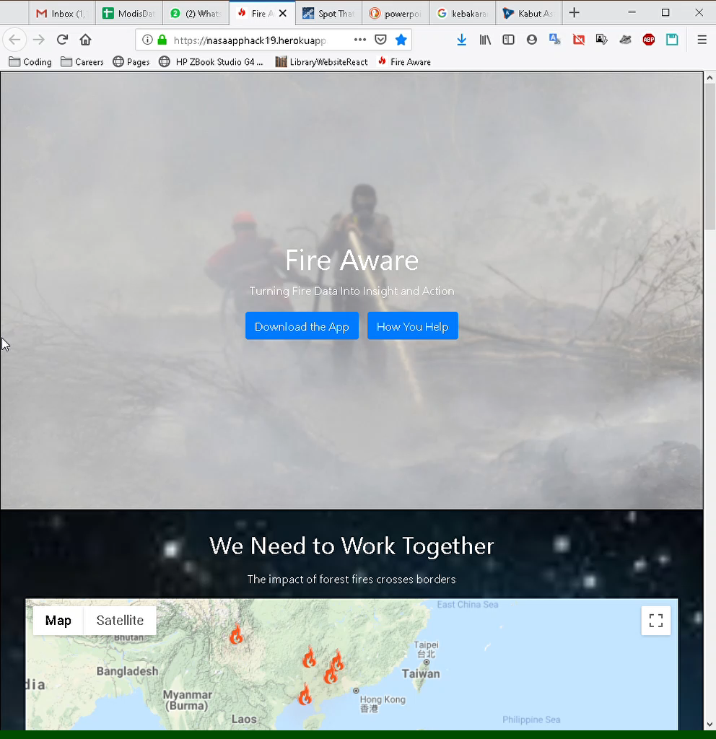
Our core premises
Web app
Accessible and visual tool to track and visualise change in fires over time
Encourage citizen participation by opening engagement with NGOs
Highlight and promote efforts of active NGOs

Slide 6
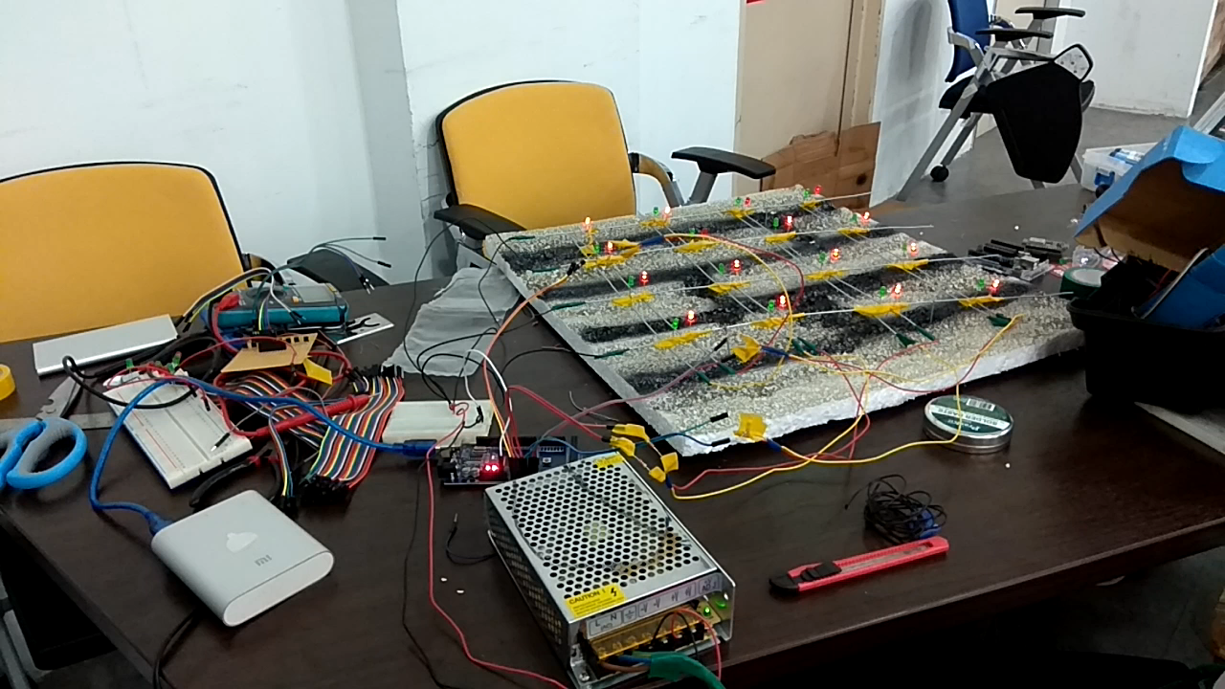
Our core premises
Street level alert system

Slide 7
Target audience
Citizens
Accessible and visual tool to track and visualise change in fires over time
Encourage citizen participation by opening engagement with NGOs
NGOs
Provide manpower and resources from citizens to assist in fire prevention and rehabilitation
Enforcement agencies
Direct fire fighting efforts
Track location of potential offenders
Policy makers
Inform decision makers of magnitude of situation

Slide 8
Q&A

Slide 9
Thank you

